Slide 1
Mentorship, Networking, and Professional Development

Slide 2
Learner Objectives
At the conclusion of this module, the learner will be able to:
Explain the value of having a close mentor in the field as you progress into clinical fellowship year (CFY) and beyond for ongoing support
Identify the volunteer opportunities available within state and national association to support the ongoing development of the profession
Evaluate and navigate and find ongoing continuing education (CE) opportunities in order to maintain required knowledge regarding the latest research related to the scope of practice in which you practice

Slide 3
Some of the questions we will answer in this module …
What is mentoring?
What is networking?
What is evidenced based practice?
What is continuing education?

Slide 4
What is mentoring?
Mentoring is a one-to-one trusting relationship that encompasses formal or informal supporting, guiding, coaching, teaching, role modeling, counseling, advocating and networking.
Mentoring occurs within and/or outside of the clinical setting and includes personal and career guidance.

Slide 5
What does a successful Mentoring relationship consist of?
Mutual respect
respect for the mentor and mentee’s time, effort, and qualifications
Shared values
Around the mentor and mentee’s approach to research, clinical work, and personal life
Reciprocity
Bidirectional nature of mentoring, including consideration of strategies to make the relationship sustainable and mutually rewarding
Personal connections
connection between the mentor and mentee
Clear Expectations
Expectations of the relationship are outlined at the onset and revisited over time; both mentor and mentee are held accountable to these expectations

Slide 6
Where to find Mentors?
Seek support from clinical supervisors, CFY supervisors and colleagues upon entering the profession
Find other colleagues in the profession that you can foster professional relationship with
Find an opportunity to discuss clinical and career decisions with your mentor to aid with ongoing support

Slide 7
Professional Networking
Building professional interactions and professional relationships that may help guide career decisions, involve knowledge sharing and mutual professional development
Professional networks help to support and guide when looking for employment and career advancement
Developing professional relationships, attending professional conferences and utilizing professional networking websites all serve to facilitate the exchange of ideas and information vital to keeping knowledge fresh and relevant

Slide 8
Ways to Promote Professional Networking
Get involved in NSSLHA chapter
Join TSHA and volunteer to support profession
Find other colleagues in similar field interest
Attend yearly state and national conferences
Attend yearly state and national conferences
Use of Facebook networking with TSHA Medical Committee page, Medical SLP Forum page to ask questions and facilitate professional discussions
Get involved with ASHA

Slide 9
Where to find Continuing Education?
Formal lectures, courses, seminars, webinars or other similar type of educational program designed to educate an individual that may be applied to daily clinical work.
Continuing education often provides updates with research and advancements to build upon expertise.
Continuing education is required to maintain certification and licensure.

Slide 10
Where to find Continuing Education?
Online posts, i.e., TSHA Medical Committee Facebook page, local SLP Chapter for professionals, Medical SLP Forum
Professional organizations, such as Brain Injury Association of America
ASHA website
Institution of practicum or employment
Pamphlets sent in mail

Slide 11
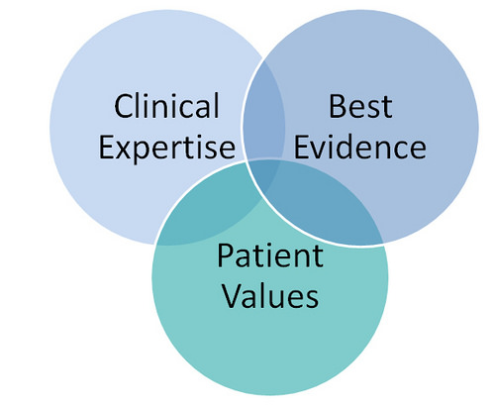
Evidenced Based Practice
Integrating individual clinical expertise with the best available external clinical evidence from systematic research
Evidenced based practice helps to support decision making needed for providing high quality patient care

Slide 12
American Speech Language Hearing Association (ASHA)
You will then join ASHA and benefit from membership benefits
Money Saving Discounts
CEU professional development products, ASHA CE Registry, Various money discounts
Knowledge
The ASHA Leader, ASHA Journals and Perspectives
Learning
ASHA Continuing Professional Education Opportunities, ASHA CE Registry, ASHA’s Practice Portal
Career Building
STEP, online mentoring program where student participants are paired with professionals
Advocacy
Reimbursement, health care coverage, educational policies.
Community
ASHA Community, Special Interest Groups, Member Directory
After completion of your Clinical Fellowship Year you can submit your application for Certificate of Clinical Competence in Speech Language Pathology (CCC-SLP)
https://www.asha.org/

Slide 13
Ways to get Involved
MISSION: Empowering and supporting speech-language pathologists, audiologists, and speech, language, and hearing scientists through advancing science, setting standards, fostering excellence in professional practice, and advocating for members and those they serve.
MISSION: Empowering members to provide the highest quality, life-changing care for individuals with communication and related disorders
https://www.txsha.org/
https://www.asha.org/

Slide 14
American Speech Language Hearing Association
When you're part of an ASHA Special Interest Group (SIG), you're part of an engaged community of professionals who are just as passionate as you!
19 SIGS. At least one's right for you! What's your interest?
http://www.asha.org/SIG/Join/
Benefits:
Saving
Earn CEUs for $5
Get SIG-only discounts
Learning
Stay on top of your game with Perspectives
Get or give advice
Connecting
ASHA community page
Volunteer with your SIG

Slide 15
Why join TSHA?
Volunteer on a committee
Be a part of your profession and give back to be a part of decisions made at the state level
www.txsha.org
Legislative Advocacy
Monitors legislative issues that affect you and your job
Address issues related to reimbursement, quality of service delivery and licensure
Why pay TSHA dues?
Used to support the needs of members, staff, overhead, software, creating and administering new e-learning, CE registry, consultants (legal personnel, PAC management, legislative work, CE processor), board and committee meetings
TSHA CE Registry
Receive Publications
Career Awareness Information
Online Ethics Course
Continuing Education, Speech Impairment Legibility Guidelines
Online Membership Directory
Scholarships, Research Grants and Service Awards

