Slide 1
PROFESSIONALISM

Slide 2
Learner Objectives
At the conclusion of this module, the learner will be able to:
Identify key concepts required for professional success
Explain the differences between successful and unsuccessful professional communication
List two key vocabulary terms that will promote entry into medical setting a success
Notes:
Changed verbs

Slide 3
Find your strengths & understand that others are different
Tom Rath’s Strengthsfinder 2.0
https://www.gallupstrengthscenter.com/?utm_source=google&utm_medium=cpc&utm_campaign=Strengths_ECommerce_Brand_Search_US&utm_content=strengthsfinder&gclid=Cj0KCQjw3uboBRDCARIsAO2XcYBYiWjLo4Ze4VOaonkA3d0hhEdTcq5vZCV6i39RViJMB09de6SN57caAtdrEALw_wcB
Meyers-Briggs assessment
https://www.mbtionline.com/TaketheMBTI?gclid=Cj0KCQjw3uboBRDCARIsAO2XcYCg3Ca2oNcczH-wHBGW1RwJCPnmtMud497-gdD1-SExm9MQI-SE9WcaAlm2EALw_wcB

Slide 4
Build Emotional Intelligence

Slide 5
What is Emotional Intelligence?
The ability to manage ourselves and our emotions effectively
The ability to get along with others
It’s all about relationships:
Be available
Be dependable
Be helpful
Be friendly
Be involved
Be thankful

Slide 6
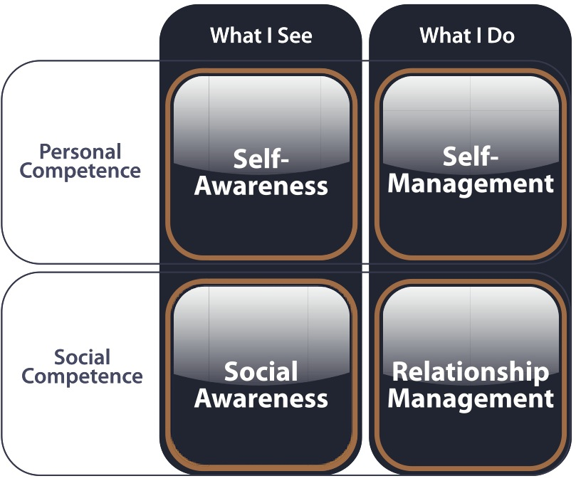
How do I manage my life?
Who am I?
How do I connect with others?
How do I manage relationships?

Slide 7
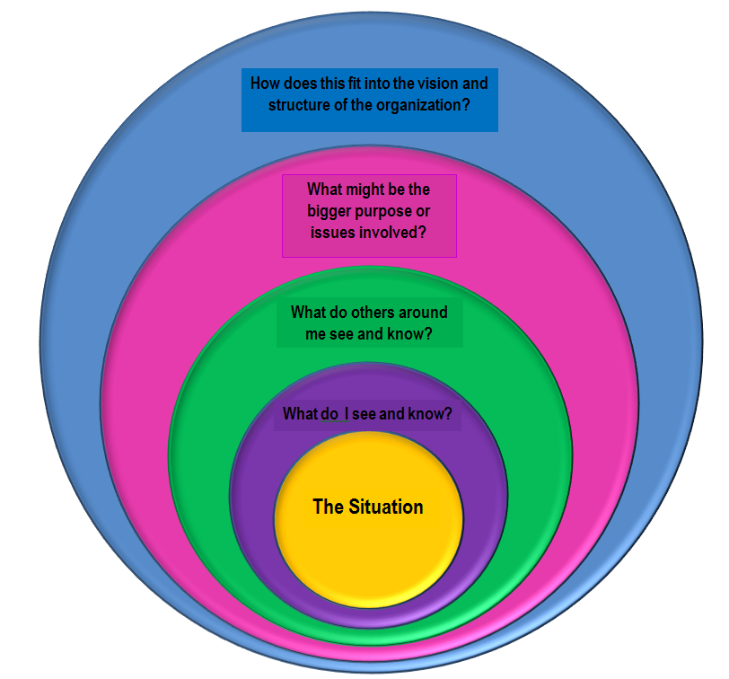
Telescoping
Be a leader in your sphere of influence
Start by learning how to navigate change in a productive and positive way

Slide 8
Social Media: Proceed with Caution
Respect patient privacy. Never post any patient or family related information.
Use good judgment regarding what you post. Consider what you post through the lens of a future employer.
Present yourself in a positive and professional manner.

Slide 9
Develop Excellent Communication Skills

Slide 10
Active Listening
Focus on speaker
Empathize
Acknowledge
Don’t interrupt
Ask questions
Paraphrase to confirm understanding

Slide 11
Barriers to Effective Communication
Divided/competing attention
Distraction
Thinking about next response
Emotions/interpersonal relationship with speaker
Personal filters, assumptions, judgments, biases, culture, and beliefs

Slide 12
How do challenging conversations make you feel?

Slide 13
Plan your discussion – but don’t make it a script!

Slide 14
Crucial Conversations: A Great Resource!
Start with heart
Learn to look
Make it safe
Master my story
State my path
Explore others’ paths
Move to action
Book authors: Kerry Patterson, Joseph Grenny, Ron McMillan, and Al Switzler

Slide 15
Interaction Guidelines
STEPS | DESCRIPTION
Open | Describe purpose of discussion Identify importance
Clarify | Seek and share information about the situation Seek issues and concerns
Develop | Seek and discuss ideas Explore needed resources/support
Agree | Specify actions, including contingency plans Confirm how to track progress and measure results
Close | Highlight important features of plans Confirm confidence and commitment

Slide 16
“Develop resiliency and be brave.”
-Renee James, former President of Intel
https://www.pexels.com/
Notes:
Photo from: pexels.com (free/no copyright photo downloads)

Slide 17
Resiliency:
The Ability to Bounce Back

Slide 18
How to build your own resiliency
Develop support networks
Clarify purpose
Build self-awareness
Enhance self-care
Actualize strengths
Broaden coping strategies
Nourse, 2015

Slide 19
Perseverance
Build a lifestyle habit of being persistent
Have appropriate expectations
Success is a journey, not a destination
Be resilient and flexible
Keep the big picture in mind
Maxwell, 2011

Slide 20
Time Management Priorities
We all have rules and deadlines to live by, but what are your priorities within those guidelines?
Returning phone calls that day
Completing reports early
Keeping your desk clean
Planning the most exciting therapy
Answering emails within an hour
Being available to coworkers & students
Reading the latest research

Slide 21
Charles E. Hummel : “The greatest danger is letting the urgent things crowd out the important."
URGENT
Important BUT Not Urgent | Important AND Urgent
Not Important OR Not Urgent | Not Important BUT Urgent
IMPORTANT

Slide 22
Dealing with Email
Get rid of notifications.
Set specific times of the day to process email.
How many times do you look at each message?
If you can respond in less than two minutes, do it now.
If you can delete or archive it, do it now.
If you need to read it later, save it elsewhere.
If a longer response is required, leave it in your inbox.
Notes:
Removed picture – not necessary

Slide 23
References
Allen, D. (2001). Getting things done: The art of stress-free productivity. New York: Penguin.
Goleman, D. (1995). Emotional intelligence. New York: Bantam Books.
Hummel, C. E. (1997). Freedom from tyranny of the urgent. Downers Grove, IL: InterVarsity Press.
Maxwell, J. C. (2011). Beyond talent: Become someone who gets extraordinary results. Nashville, TN: Thomas Nelson.
Myers, I. B. (1980). Gifts differing. Palo Alto, CA: Consulting psychologists Press.
Nourse, K. (2015, November 01). Get Your Bounce Back. Retrieved April 16, 2018, from https://leader.pubs.asha.org/article.aspx?articleid=2468395
Patterson, K., Grenny, J., & Switzler, A. (2012). Crucial conversations. New York: McGraw-Hill.

